Slide 1
Application Development on Location Guardian
2210315710 - Venkat Sai Charan Bandi

Slide 2
Abstract
This is an android application which is used for security purpose. Here, the app has guardians and users, where user adds other people as guardians. When the user does not pick up the call, the details of the users location is sent to the guardian. Here the address will be sent, which can be located on the map. And this application should be installed on both the guardians and users phone. So, only the guardian will receive the location details of the user if the call is not received, but not when the user calls and when the guardian does not lift the phone

Slide 3
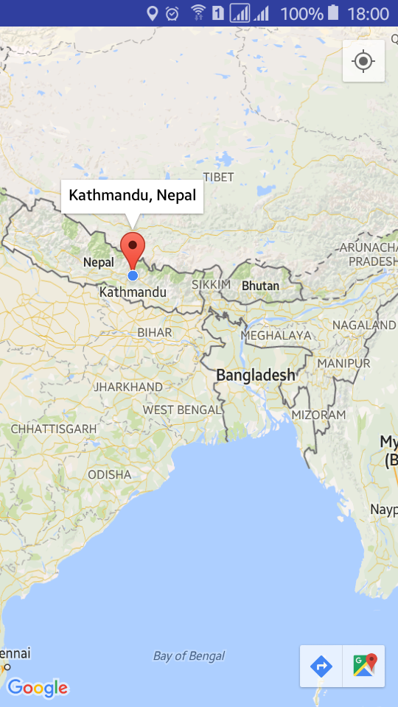
Objective
Here the main objective is to provide security for people.
The main purpose is to send the location of user to the guardian.
We can get the location of the person when the person does not lift the phone.
We can even see the map regarding the location.

Slide 4
Hardware Requirements
Android OS Mobile
512 Mb RAM & Above
Storage Space >100Mb
Cellular/Wi-Fi Network
GPS Sensor Enabled

Slide 5
Software Requirements
Android Studio / Eclipse IDE
Windows OS
Android SDK 2.2 & Above

Slide 6
Existing System
1. At times, people might not attend the call due to some reason and the people who care about them might get tensed.
2. We are not having any application for security reasons like this. Hence, we are proposing the following solution.
Proposed System
1. Here the location is sent in the form of latitude and longitude.
2. The location details will be converted into address internally in the application and the address is sent to the guardian.
3. We even provide a special feature of seeing that location in the map using this application.

